Slide 1
Chapter 5
Names, Bindings, and Scopes

Slide 2
Chapter 5 Topics
Introduction
Names
Variables
The Concept of Binding
Scope
Scope and Lifetime
Referencing Environments
Named Constants
Copyright © 2017 Pearson Education, Ltd. All rights reserved.
1-<number>

Slide 3
Introduction
Imperative languages are abstractions of von Neumann architecture
  Memory
  Processor
Variables are characterized by attributes
  To design a type, must consider scope, lifetime, type checking, initialization, and type compatibility
Copyright © 2017 Pearson Education, Ltd. All rights reserved.
1-<number>

Slide 4
Names
Design issues for names:
  Are names case sensitive?
  Are special words reserved words or keywords?
Copyright © 2017 Pearson Education, Ltd. All rights reserved.
1-<number>

Slide 5
Names (continued)
Length
  If too short, they cannot be connotative
  Language examples:
    C99: no limit but only the first 63 are significant; also, external names are limited to a maximum of 31
    C# and Java: no limit, and all are significant
    C++: no limit, but implementers often impose one
    Connotative: it does not evoke something
Copyright © 2017 Pearson Education, Ltd. All rights reserved.
1-<number>

Slide 6
Names (continued)
Special characters
  PHP: all variable names must begin with dollar signs
  Perl: all variable names begin with special characters, which specify the variable’s type
  Ruby: variable names that begin with @ are instance variables; those that begin with @@ are class variables
Copyright © 2017 Pearson Education, Ltd. All rights reserved.
1-<number>

Slide 7
Names (continued)
Case sensitivity
  Disadvantage: readability (names that look alike are different)
    Names in the C-based languages are case sensitive
    Names in others are not
    Worse in C++, Java, and C# because predefined names are mixed case (e.g. IndexOutOfBoundsException)
Copyright © 2017 Pearson Education, Ltd. All rights reserved.
1-<number>

Slide 8
Names (continued)
Special words
  An aid to readability; used to delimit or separate statement clauses
  A keyword is a word that is special only in
  certain contexts
  A reserved word is a special word that cannot be used as a user-defined name
  Potential problem with reserved words: If there are too many, many collisions occur (e.g., COBOL has 300 reserved words!)
Copyright © 2017 Pearson Education, Ltd. All rights reserved.
1-<number>

Slide 9
Variables
A variable is an abstraction of a memory cell
Variables can be characterized as a sextuple of attributes:
  Name
  Address
  Value
  Type
  Lifetime
  Scope
Copyright © 2017 Pearson Education, Ltd. All rights reserved.
1-<number>

Slide 10
Variables Attributes
Name - not all variables have them
Address - the memory address with which it is associated
  A variable may have different addresses at different times during execution
  A variable may have different addresses at different places in a program
  If two variable names can be used to access the same memory location, they are called aliases
  Aliases are created via pointers, reference variables, C and C++ unions
  Aliases are harmful to readability (program readers must remember all of them)
Copyright © 2017 Pearson Education, Ltd. All rights reserved.
1-<number>

Slide 11
Variables Attributes (continued)
Type - determines the range of values of variables and the set of operations that are defined for values of that type; in the case of floating point, type also determines the precision
Value - the contents of the location with which the variable is associated
- The l-value of a variable is its address
- The r-value of a variable is its value
Abstract memory cell - the physical cell or collection of cells associated with a variable
Copyright © 2017 Pearson Education, Ltd. All rights reserved.
1-<number>

Slide 12
The Concept of Binding
A binding is an association between an entity and an attribute, such as between a variable and its type or value, or between an operation and a symbol
Binding time is the time at which a binding takes place.
Copyright © 2017 Pearson Education, Ltd. All rights reserved.
1-<number>

Slide 13
Possible Binding Times
Language design time -- bind operator symbols to operations
Language implementation time-- bind floating point type to a representation
Compile time -- bind a variable to a type in C or Java
Load time -- bind a C or C++ static variable to a memory cell)
Runtime -- bind a nonstatic local variable to a memory cell
Copyright © 2017 Pearson Education, Ltd. All rights reserved.
1-<number>

Slide 14
Static and Dynamic Binding
A binding is static if it first occurs before run time and remains unchanged throughout program execution.
A binding is dynamic if it first occurs during execution or can change during execution of the program
Copyright © 2017 Pearson Education, Ltd. All rights reserved.
1-<number>

Slide 15
Type Binding
How is a type specified?
When does the binding take place?
If static, the type may be specified by either an explicit or an implicit declaration
Copyright © 2017 Pearson Education, Ltd. All rights reserved.
1-<number>

Slide 16
Explicit/Implicit Declaration
An explicit declaration is a program statement used for declaring the types of variables
An implicit declaration is a default mechanism for specifying types of variables through default conventions, rather than declaration statements
Basic, Perl, Ruby, JavaScript, and PHP provide implicit declarations
  Advantage: writability (a minor convenience)
  Disadvantage: reliability (less trouble with Perl)
Copyright © 2017 Pearson Education, Ltd. All rights reserved.
1-<number>

Slide 17
Explicit/Implicit Declaration (continued)
Some languages use type inferencing to determine types of variables (context)
  C# - a variable can be declared with var and an initial value. The initial value sets the type
  Visual Basic 9.0+, ML, Haskell, and F# use type inferencing. The context of the appearance of a variable determines its type
Copyright © 2017 Pearson Education, Ltd. All rights reserved.
1-<number>

Slide 18
Dynamic Type Binding
Dynamic Type Binding (JavaScript, Python, Ruby, PHP, and C# (limited))
Specified through an assignment statement e.g., JavaScript
list = [2, 4.33, 6, 8];
list = 17.3;
  Advantage: flexibility (generic program units)
  Disadvantages:
    High cost (dynamic type checking and interpretation)
    Type error detection by the compiler is difficult
Copyright © 2017 Pearson Education, Ltd. All rights reserved.
1-<number>

Slide 19
Variable Attributes (continued)
Storage Bindings & Lifetime
  Allocation - getting a cell from some pool of available cells
  Deallocation - putting a cell back into the pool
The lifetime of a variable is the time during which it is bound to a particular memory cell
Copyright © 2017 Pearson Education, Ltd. All rights reserved.
1-<number>

Slide 20
Categories of Variables by Lifetimes
Static--bound to memory cells before execution begins and remains bound to the same memory cell throughout execution, e.g., C and C++ static variables in functions
  Advantages: efficiency (direct addressing)
  Disadvantage: lack of flexibility (no recursion)
Copyright © 2017 Pearson Education, Ltd. All rights reserved.
1-<number>

Slide 21
Categories of Variables by Lifetimes
Stack-dynamic--Storage bindings are created for variables when their declaration statements are elaborated.
(A declaration is elaborated when the executable code associated with it is executed)
If scalar, all attributes except address are statically bound
  local variables in C subprograms (not declared static) and Java methods
Advantage: allows recursion; conserves storage
Disadvantages:
  Overhead of allocation and deallocation
Copyright © 2017 Pearson Education, Ltd. All rights reserved.
1-<number>

Slide 22
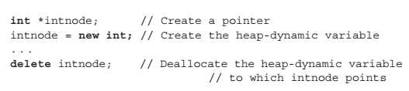
Categories of Variables by Lifetimes
Explicit heap-dynamic -- Allocated and deallocated by explicit directives, specified by the programmer, which take effect during execution
Referenced only through pointers or references, e.g. dynamic objects in C++ (via new and delete), all objects in Java
Advantage: provides for dynamic storage management
Disadvantage: inefficient and unreliable
Copyright © 2017 Pearson Education, Ltd. All rights reserved.
1-<number>

Slide 23

Categories of Variables by Lifetimes
Implicit heap-dynamic--Allocation and deallocation caused by assignment statements
  Vars → bound to heap storage only when they are assigned values. In fact, all their attributes are bound every time they are assigned.
  all variables in APL; all strings and arrays in Perl, JavaScript, and PHP
Advantage: flexibility (generic code)
Disadvantages:
  Inefficient, because all attributes are dynamic
Copyright © 2017 Pearson Education, Ltd. All rights reserved.
1-<number>

Slide 24
Variable Attributes: Scope
The scope of a variable is the range of statements over which it is visible
The local variables of a program unit are those that are declared in that unit
The nonlocal variables of a program unit are those that are visible in the unit but not declared there
Global variables are a special category of nonlocal variables
The scope rules of a language determine how references to names are associated with variables
Copyright © 2017 Pearson Education, Ltd. All rights reserved.
1-<number>

Slide 25
Static Scope
Based on program text
To connect a name reference to a variable, you (or the compiler) must find the declaration
Search process: search declarations, first locally, then in increasingly larger enclosing scopes, until one is found for the given name
Enclosing static scopes (to a specific scope) are called its static ancestors; the nearest static ancestor is called a static parent
Some languages allow nested subprogram definitions, which create nested static scopes (e.g., Ada, JavaScript, Common Lisp, Scheme, Fortran 2003+, F#, and Python)
Copyright © 2017 Pearson Education, Ltd. All rights reserved.
1-<number>

Slide 26
Scope (continued)
Variables can be hidden from a unit by having a "closer" variable with the same name
Copyright © 2017 Pearson Education, Ltd. All rights reserved.
1-<number>

Slide 27
Blocks
  A method of creating static scopes inside program units--from ALGOL 60
  Example in C:
void sub() {
int count;
while (...) {
int count;
count++;
...
}
…
}
- Note: legal in C and C++, but not in Java
and C# - too error-prone
Copyright © 2017 Pearson Education, Ltd. All rights reserved.
1-<number>

Slide 28
The LET Construct
Most functional languages include some form of let construct
A let construct has two parts
  The first part binds names to values
  The second part uses the names defined in the first part
In Scheme:
(LET (
(name₁ expression₁)
…
(name_{n} expression_{n})
)
Copyright © 2017 Pearson Education, Ltd. All rights reserved.
1-<number>

Slide 29
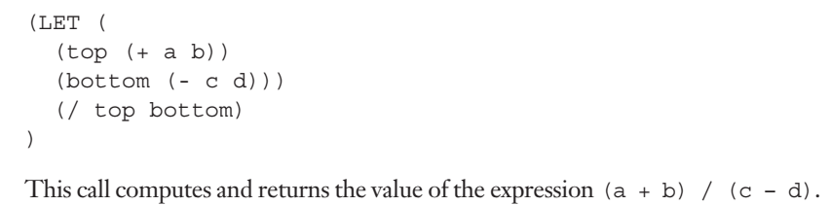
SCHEME
Copyright © 2017 Pearson Education, Ltd. All rights reserved.
1-<number>

Slide 30
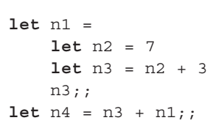
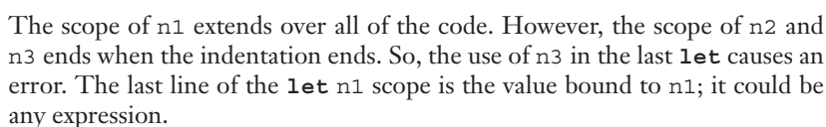
F#
→ indentation
ERROR!!!
n2 and n3 are in a local SCOPE!
Copyright © 2017 Pearson Education, Ltd. All rights reserved.
1-<number>

Slide 31
The LET Construct (continued)
In ML:
let
val name₁ = expression₁
…
val name_{n} = expression_{n}
in
expression
end;
In F#:
  First part: let left_side = expression
  (left_side is either a name or a tuple pattern)
  All that follows is the second part
Copyright © 2017 Pearson Education, Ltd. All rights reserved.
1-<number>

Slide 32
Declaration Order
C99, C++, Java, and C# allow variable declarations to appear anywhere a statement can appear
  In C99, C++, and Java, the scope of all local variables is from the declaration to the end of the block
  In C#, the scope of any variable declared in a block is the whole block, regardless of the position of the declaration in the block
    However, a variable still must be declared before it can be used
Copyright © 2017 Pearson Education, Ltd. All rights reserved.
1-<number>

Slide 33
Declaration Order (continued)
In C++, Java, and C#, variables can be declared in for statements
  The scope of such variables is restricted to the for construct
Copyright © 2017 Pearson Education, Ltd. All rights reserved.
1-<number>

Slide 34
Global Scope
C, C++, PHP, and Python support a program structure that consists of a sequence of function definitions in a file
  These languages allow variable declarations to appear outside function definitions
C and C++have both declarations (just attributes) and definitions (attributes and storage)
  A declaration outside a function definition specifies that it is defined in another file
Copyright © 2017 Pearson Education, Ltd. All rights reserved.
1-<number>

Slide 35
Global Scope (continued)
PHP
  Programs are embedded in HTML markup documents, in any number of fragments, some statements and some function definitions
  The scope of a variable (implicitly) declared in a function is local to the function
  The scope of a variable implicitly declared outside functions is from the declaration to the end of the program, but skips over any intervening functions
    Global variables can be accessed in a function through the $GLOBALS array or by declaring it global
Copyright © 2017 Pearson Education, Ltd. All rights reserved.
1-<number>

Slide 36
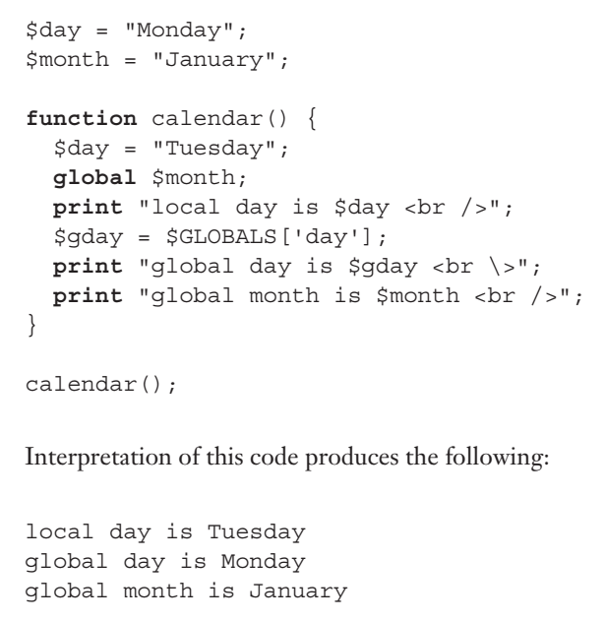
PHP
Copyright © 2017 Pearson Education, Ltd. All rights reserved.
1-<number>

Slide 37
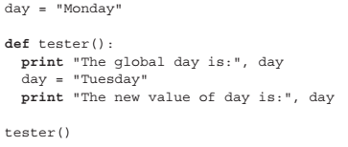
Global Scope (continued)
Python
  A global variable can be referenced in functions, but can be assigned in a function only if it has been declared to be global in the function
ERROR
Copyright © 2017 Pearson Education, Ltd. All rights reserved.
1-<number>

Slide 38
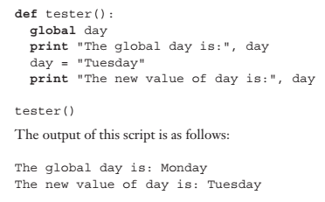
NO ERROR!
Copyright © 2017 Pearson Education, Ltd. All rights reserved.
1-<number>

Slide 39
Evaluation of Static Scoping
Works well in many situations
Problems:
  In most cases, too much access is possible
  As a program evolves, the initial structure is destroyed and local variables often become global; subprograms also gravitate toward become global, rather than nested
Copyright © 2017 Pearson Education, Ltd. All rights reserved.
1-<number>

Slide 40
Dynamic Scope
Based on calling sequences of program units, not their textual layout (temporal versus spatial)
References to variables are connected to declarations by searching back through the chain of subprogram calls that forced execution to this point
Copyright © 2017 Pearson Education, Ltd. All rights reserved.
1-<number>

Slide 41
Scope Example
function big() {
function sub1(){
var x = 7;
}
function sub2() {
var y = x;
}
var x = 3;
}
  Static scoping
    Reference to x in sub2 is to big's x
  Dynamic scoping
    Reference to x in sub2 is to sub1's x
big calls sub1
sub1 calls sub2
sub2 uses x
Copyright © 2017 Pearson Education, Ltd. All rights reserved.
1-<number>

Slide 42
Scope Example
Evaluation of Dynamic Scoping:
  Advantage: convenience (comfort, ease)
  Disadvantages:
    While a subprogram is executing, its variables are visible to all subprograms it calls
    Impossible to statically type check
    3. Poor readability- it is not possible to statically
    determine the type of a variable
Copyright © 2017 Pearson Education, Ltd. All rights reserved.
1-<number>

Slide 43
Scope and Lifetime
Scope and lifetime are sometimes closely related, but are different concepts
Consider a static variable in a C or C++ function
Copyright © 2017 Pearson Education, Ltd. All rights reserved.
1-<number>

Slide 44
Referencing Environments
The referencing environment of a statement is the collection of all names that are visible in the statement
In a static-scoped language, it is the local variables plus all of the visible variables in all of the enclosing scopes
A subprogram is active if its execution has begun but has not yet terminated
In a dynamic-scoped language, the referencing environment is the local variables plus all visible variables in all active subprograms
Copyright © 2017 Pearson Education, Ltd. All rights reserved.
1-<number>

Slide 45
Named Constants
A named constant is a variable that is bound to a value only ONCE
Advantages: readability and modifiability
  pi instead of 3.14159265
Used to parameterize programs
The binding of values to named constants can be either static (called manifest constants) or dynamic
Languages:
  C++ and Java: expressions of any kind, dynamically bound
  C# has two kinds, readonly and const
  - the values of const named constants are bound at
  compile time
  - The values of readonly named constants are
  dynamically bound
Copyright © 2017 Pearson Education, Ltd. All rights reserved.
1-<number>

Slide 46
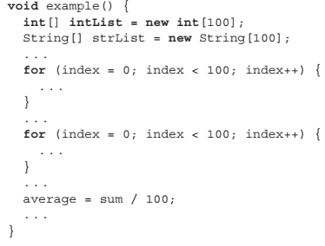
NAMED CONSTANT Java
Copyright © 2017 Pearson Education, Ltd. All rights reserved.
1-<number>

Slide 47
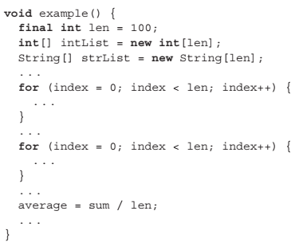
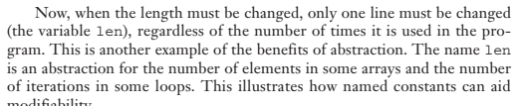
NAMED CONSTANT Java
Change ONCE!
Copyright © 2017 Pearson Education, Ltd. All rights reserved.
1-<number>

Slide 48
Summary
Case sensitivity and the relationship of names to special words represent design issues of names
Variables are characterized by the sextuples: name, address, value, type, lifetime, scope
Binding is the association of attributes with program entities
Scalar variables are categorized as: static, stack dynamic, explicit heap dynamic, implicit heap dynamic
Strong typing means detecting all type errors
Copyright © 2017 Pearson Education, Ltd. All rights reserved.
1-<number>

